Slide 1

Error Detection
and
Correction
10.
Copyright © The McGraw-Hill Companies, Inc. Permission required for reproduction or display.

Slide 2
10-4 CYCLIC CODES
Cyclic codes are special linear block codes with one extra property. In a cyclic code, if a codeword is cyclically shifted (rotated), the result is another codeword.
Topics discussed in this section:
Cyclic Redundancy Check
Hardware Implementation
Polynomials
Cyclic Code Analysis
Advantages of Cyclic Codes
Other Cyclic Codes
10.

Slide 3

Table 10.6 A CRC code with C(7, 4)
10.

Slide 4

Figure 10.14 CRC encoder and decoder
10.

Slide 5

Figure 10.15 Division in CRC encoder
10.

Slide 6

Figure 10.16 Division in the CRC decoder for two cases
10.

Slide 7
Using Polynomials
We can use a polynomial to represent a binary word.
Each bit from right to left is mapped onto a power term.
The rightmost bit represents the “0” power term. The bit next to it the “1” power term, etc.
If the bit is of value zero, the power term is deleted from the expression.

Slide 8

Figure 10.21 A polynomial to represent a binary word
10.

Slide 9

Figure 10.22 CRC division using polynomials
10.

Slide 10

Note
The divisor in a cyclic code is normally called the generator polynomial
or simply the generator.
10.

Slide 11
Note
In a cyclic code,
If s(x) ≠ 0, one or more bits is corrupted.
If s(x) = 0, either
a. No bit is corrupted. or
b. Some bits are corrupted, but the
decoder failed to detect them.
10.

Slide 12
Note
If the generator has more than one term and the coefficient of x⁰ is 1,
all single errors can be caught.
10.

Slide 13
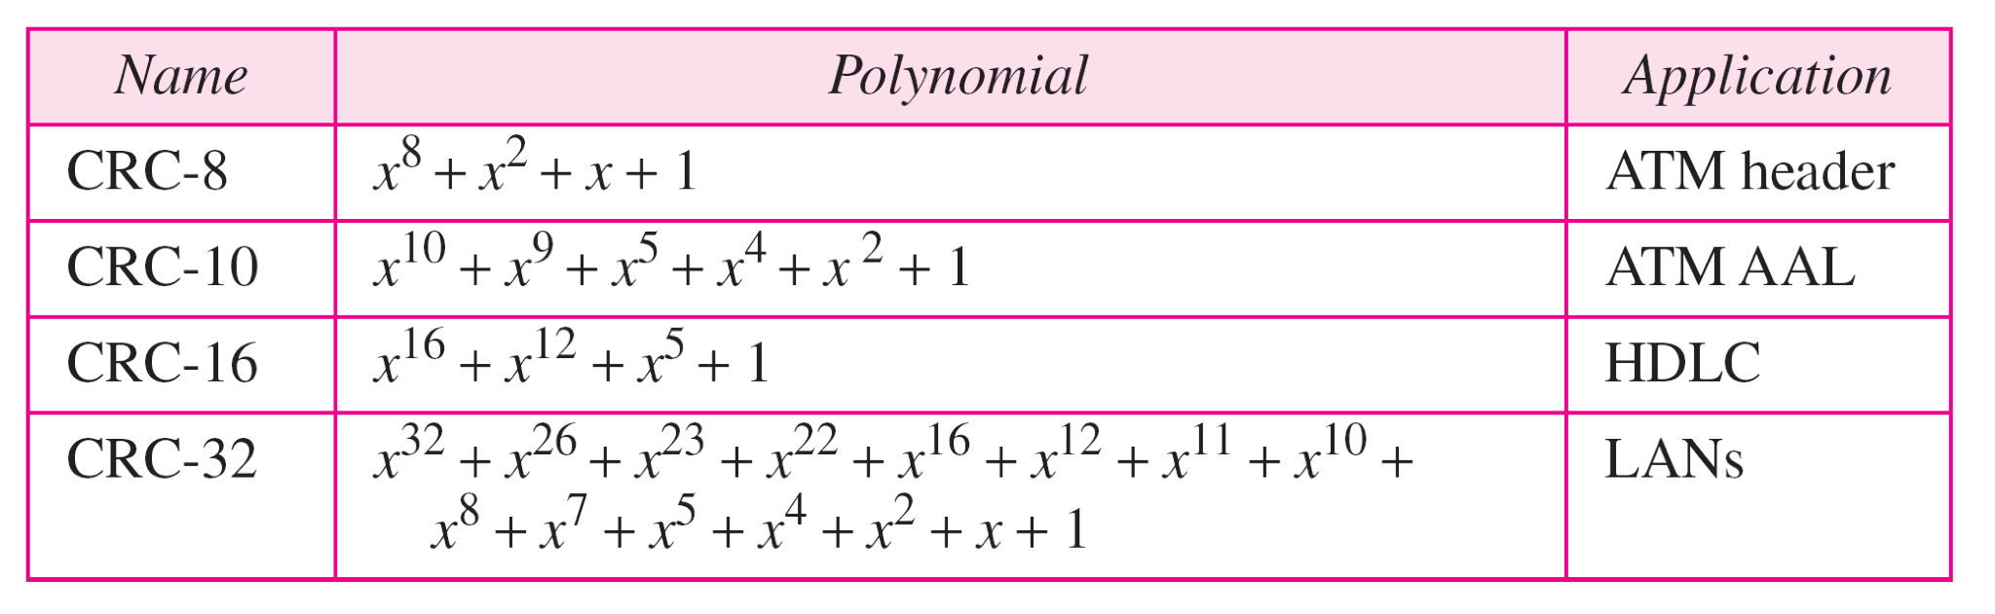
Table 10.7 Standard polynomials
10.

